Slide 1



Reverse Engineering
of Rocket-Chip
December 8-10 | Virtual Event
ASSOCIATE MEMBER CHIPS ALLIANCE
COMMUNITY ORGANIZATION MEMBER RISCV

Slide 2
December 8-10 | Virtual Event
Reverse Engineering of Rocket-Chip
Dr Roomi Naqvi
Director
MERL-PAKISTAN
#RISCVSUMMIT

Slide 3
To be covered
Goals
To reduce the complexity of Rocket-Chip
Extend to add Vector extension.
Complexity of Task
Number of Modules, functions, Number of lines, objects etc
Scala Vs Chisel
Software Methodology
UML – Class diagrams
Software spec to Micro-architecture spec
Block
Shows how the methodology was employed
Future Research
Parameterize-able Micro-Architecture
Parameterize-able I/O interface

Slide 4
Motivation and Scope
To provide a detailed elaboration and establish an understanding of Rocket-core to generate a customized System on Chip (SoC) using it. Moreover, to modify and enhance a module based on customized specifications later.
To come up with a hardware insight by mapping it to blocks of code which highlights the wiring and back tracing of input/output by means of variables. The hardware mapping creates a linkage between software and hardware in entire workflow.
The Microarchitecture Specification (MAS) Documentation developed by MERL-UIT aims to present a detailed description of Rocket-chip core and its micro-architecture to e features additional representations such as block diagrams and flowcharts.

Slide 5
Methodology
We decode basic modules of rocket chip by taking understanding of its code line by line with the help of Scala and Chisel expertise.
We convert these modules code understanding into flow charts and start making Micro Architecture Specification (MAS) documentation.
We make flow charts for different modules of Rocket Chip. After completion of flow charts, we make block diagrams of Rocket Chip modules according to its configuration pin in and out

Slide 6
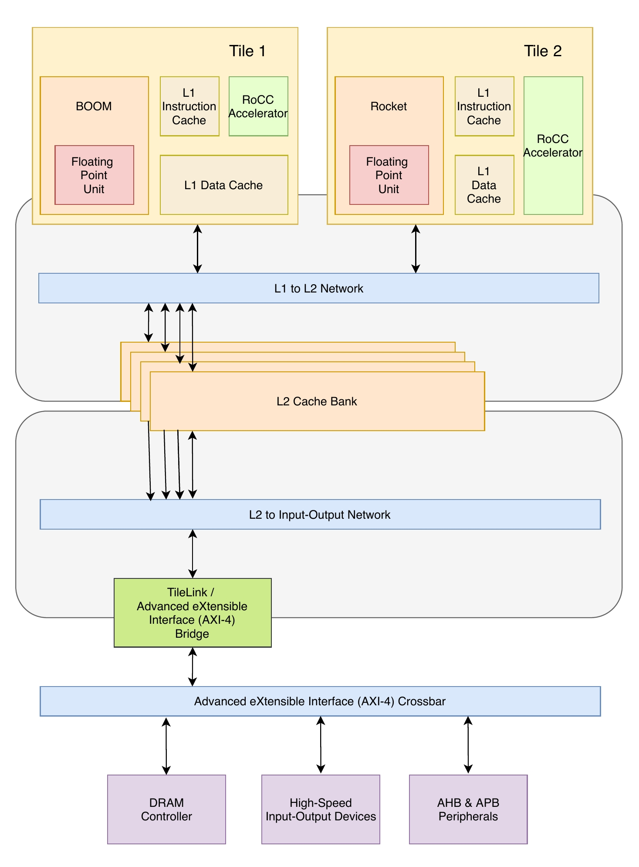
ROCKET-CHIP Overview
The entire Rocket-chip Is coded in Scala language that compiles it using one of its library ‘’chisel’’. An FIRRTL is generated by chisel which further leads to the Verilog of Rocket-chip
Rocket-chip is an SoC generator and can be configured with single or multiple processor cores, caches, on-chip busses, individual buses and bus interconnections. All these devices are a part of SoC which is referred as a sub system.
A full chip however needs some additional devices that have not been accommodated in the Rocket-chip repository which can be viewed at sifive/sifive-blocks. There are other IPs not vended open source and for this integration purpose a black box is needed with the use of diplomacy.
Diplomacy is a Scala run-time parameter negotiation and generation mechanism. It is implemented in chisel language and heavily leverages the software engineering features provided by Chisel (Scala).

Slide 7
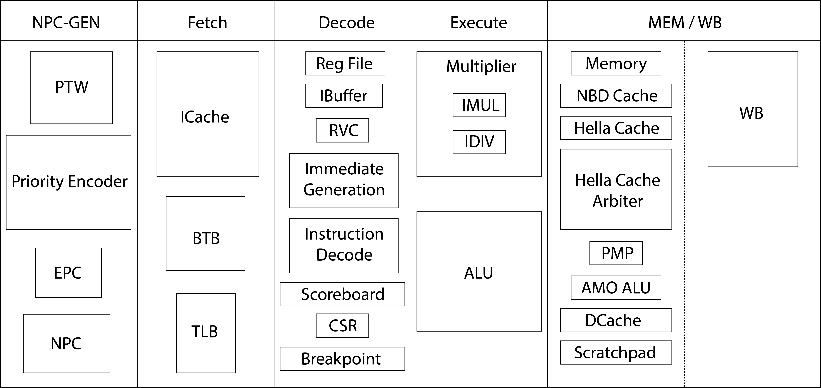
ROCKET-CHIP Micro-Architecture

Slide 8
Rocket-chip Modules Description
NPC-GEN Modules Description
Module | Description
PTW | Page table is used to access the virtual memory To Allocate/de-allocate memory in same size chunks (pages).A hardware page table walker (PTW) walks the page table
Priority Encoder | Priority Encoders take all of their data inputs one at a time and converts them into an equivalent binary code at its output
EPC | The Exception Program Counter (EPC) is used to store the address of the instruction that was executing when the exception was generated.
NPC | New Program Counter (NPC). It increments +4 in current PC and store in register.
FETCH Modules Description
Module | Description
ICache | The Instruction Cache acts as a buffer memory between external memory and the core processor.
BTB | Branch Target Buffer (BTB) is a cache-like component in processors that is used for branch prediction. The main concept of the BTB is to store the program counter (PC) of a branch instruction, and also the PC of the target of the branch.
TLB | Translation Lookaside Buffer (TLB) is memory cache which is used to keep track of recently used transactions and reduce the time taken to access a user memory location

Slide 9
DECODE Modules Description
Module | Description
Register File | Registers are temporary storage locations that hold data and addresses. The register file is the component that contains all the general-purpose registers of the microprocessor
Instruction buffer | Ibuffer is a temporary register where the opcode of the currently fetched instruction is stored.
RVC | This Module holds RISC-V Compressed (C-Extension) Instructions
Immediate Generation | This Module generates Immediate for instructions having Immediate in their Instruction Set.
Instruction Decode | This Module Decodes the Instructions coming from Instruction Memory.
Scoreboard | Scoreboards are designed to control the flow of data between registers and multiple arithmetic units in the presence of conflicts caused by hardware resource limitations (structural hazards) and by dependencies between instructions (data hazards).
CSR | Control and Status Register (CSR) is a register in many central processing units that are used as storage devices for information about instructions received from machines.
Breakpoint | A breakpoint is a location in executable code at which the operating system stops execution and breaks into the debugger. This allows you to analyze the target and issue debugger commands.

Slide 10
EXECUTE Modules Description
Module | Description
Multiplier | This module is used for multiplication for M-Type Instructions
ALU | An arithmetic logic unit (ALU) is a digital circuit used to perform arithmetic and logic operations.
MEMORY/ WRITE-BACK Modules Description
Module | Description
Memory | This module is for accessing memory
HellaCache | This is Level-1 (L1) Data Cache of the Tile.
HellaCache Arbiter | This module is for accessing L1 Dcache (HellaCache), by means of requests generated from other modules for read and write operations.
PMP | physical memory protection is used to enforce access restrictions on less privileged modes. With un-trusted user mode software, RISC-V can restrict which levels of memory that software has access to.
AMO-ALU | This Module performs Atomic Operation of A-Extension.
Dcache | This Module is used to hold the data for temporary period of time.
Scratchpad | (SPRAM) is a high-speed internal memory directly connected to the CPU core and used for temporary storage to hold very small items of data for rapid retrieval.
WB | This module performs the Write back function in the core

Slide 11
Code Complexity
The complexity of code of Rocket-chip is high, because it contains 372 files in 73 directories, after the submodules the numbers increase to 151,613 files in 8,625 directories and after running the build script to generate an SoC the numbers grow to 185,049 files in 10,780 directories¹.
The code of Rocket-chip is extensive and complex because it contains 328 source files of Scala in 23 directories, and 33,427 total lines of Scala code.
Another issue faced was that Rocket-chip contains several meaningless variable names and non-elaborated comments which further leads to uncertainty in methods, increases the complexity to decode it and makes it tough to understand the hardware inputs/outputs.
Lack of understandability and comprehension concludes to difficulty in modifying Rocket-core or its component as for customized requirements.
¹ Durrum, J., Bryant, A. and Porter, J., 2019. Reverse Engineering RISC-V Generator-Based Designs for Trust and Assurance. AFRL/RYDT WPAFB United States.

Slide 12
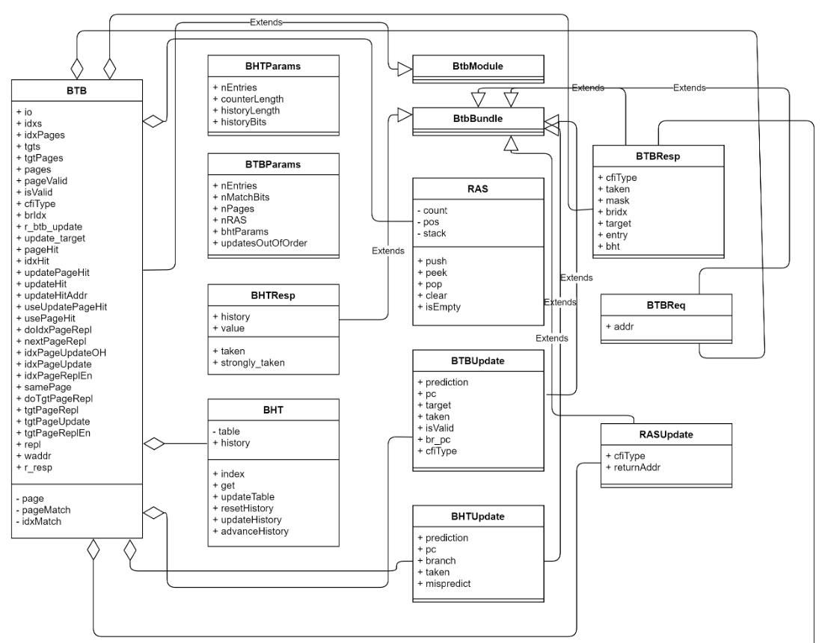
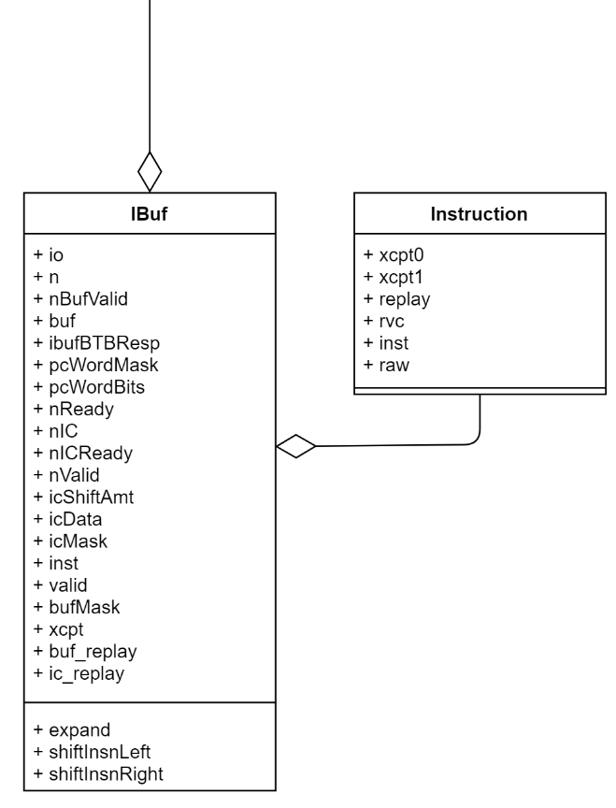
Code Hierarchy
Instruction Buffer
Branch Target Buffer (BTB)

Slide 13
Class IBuf has an instance of BTBResp initialized by the variable ibufBTBResp
Class name BTBResp
Class name IBuf
Public Attributes of class BTBResp
Public Methods of class BTBResp
Public Attributes of class IBuf
Class BTBResp is inherited/extended by another class that’s why, even though it doesn’t have any method of its own, but it can use its parent’s class methods.

Slide 14
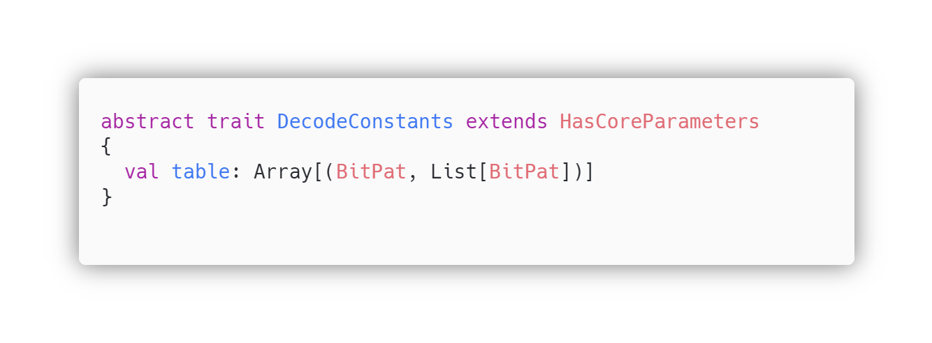
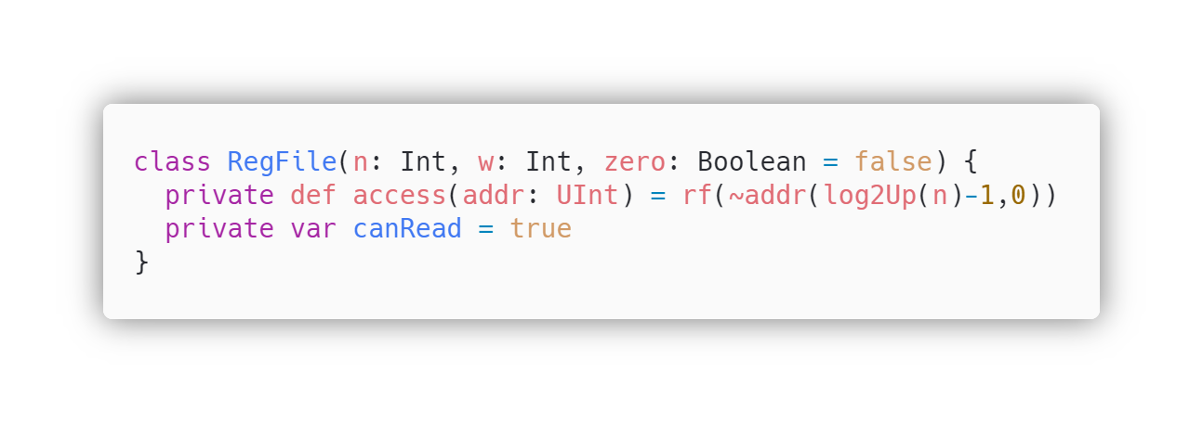
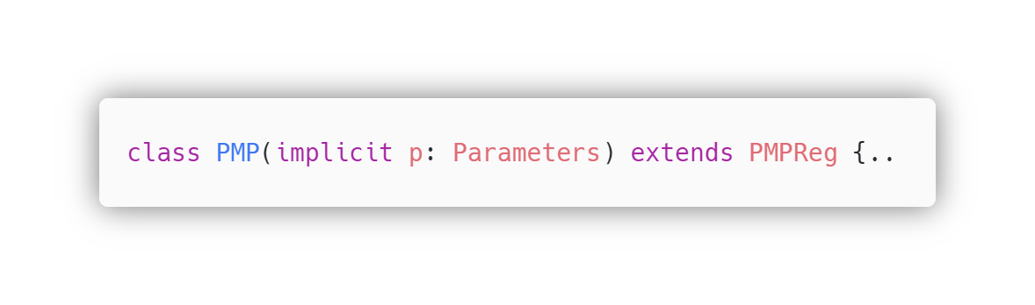
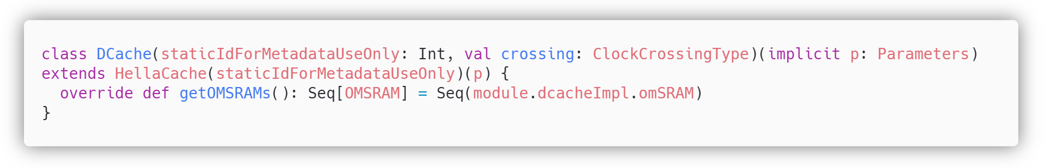
Object Oriented Code of Rocket-Chip
Abstraction
Abstraction is achieved by abstract keyword, creating an abstract trait of DecodeConstants
Encapsulation
Private access modifier is used to encapsulate/hide method ‘access’ from other extended classes
Inheritance
Keyword extend is used to extend/inherit the PMP class with parent class PMPReg
Polymorphism
Keyword override is used to override method getOMSRAMs, which is already defined in the parent class.

Slide 15
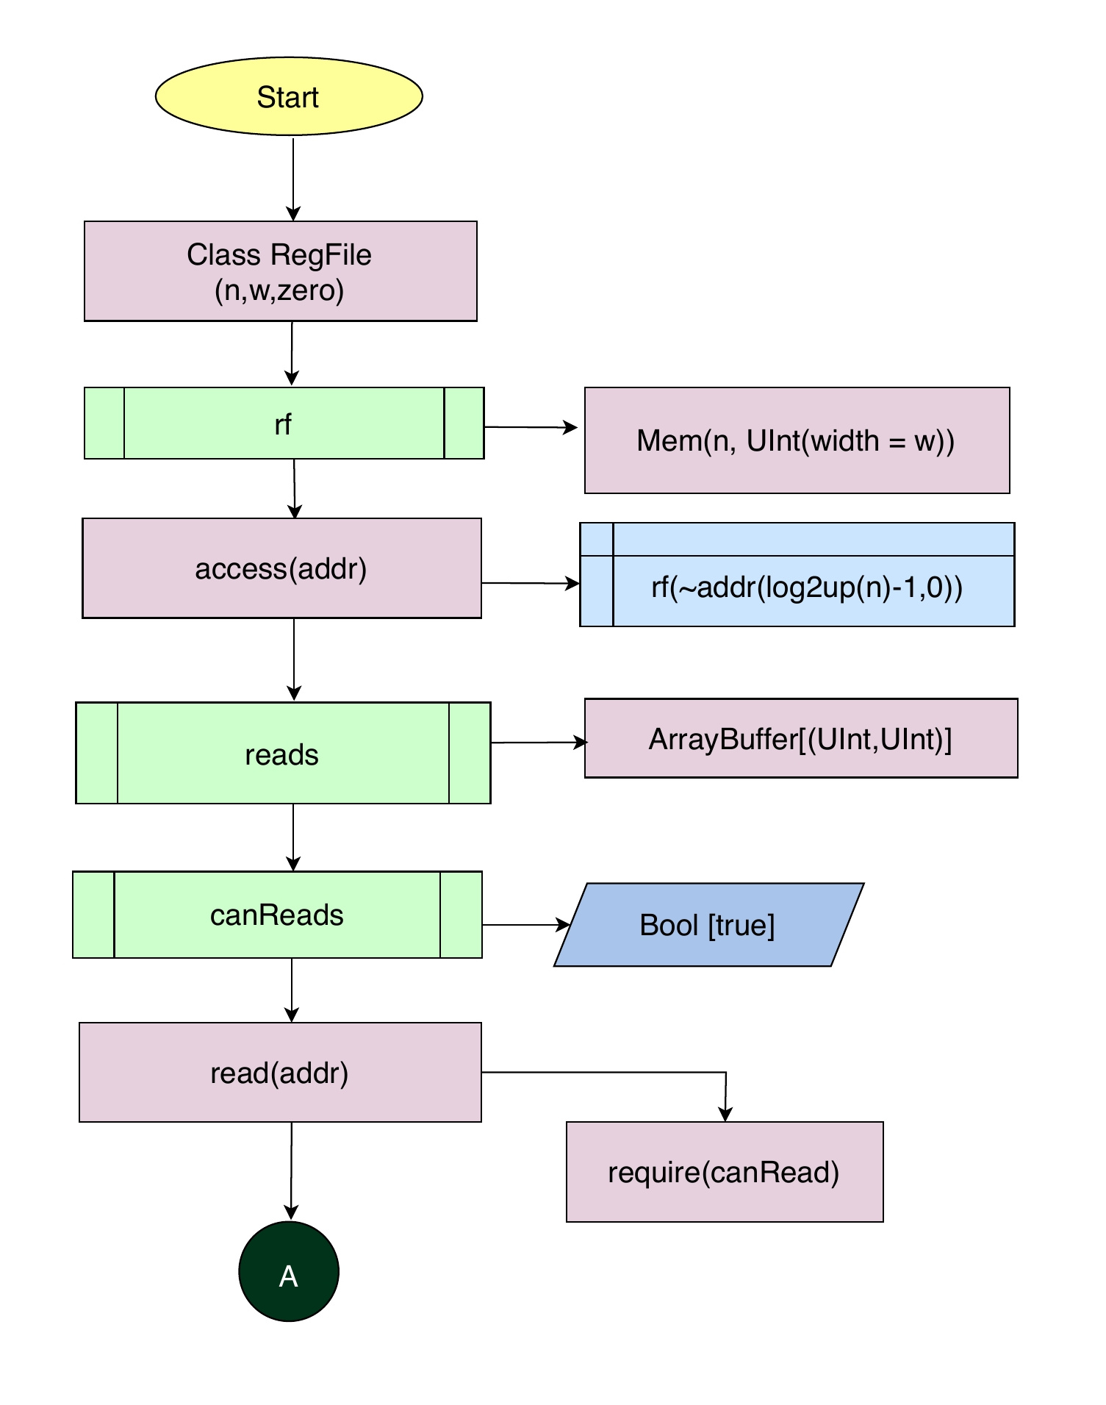
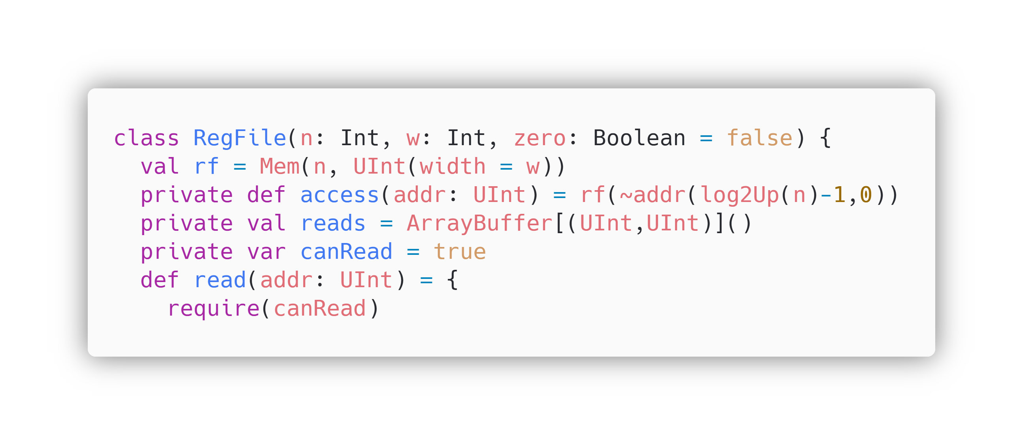
Code Explanation and Back-tracing
via Flowcharts and Block Diagram
Class RegFile is initiated with three parameters n, w and zero having type Int and Bool.
This class creates register file of rocket chip.
Mem function is used to create memory where n= depth/entries of memory and w= width of memory.
In the class RegFile, a private method named access is defined for accessing the register file data by taking the address as its input parameter.
Private variable reads calculates the address which will be used to read the data..
Private variable canRead is defined as true for read state.
For write state canRead will be false.
“read” method is defined in class RegFile to read data from register file. It takes addr as parameter.

Slide 16
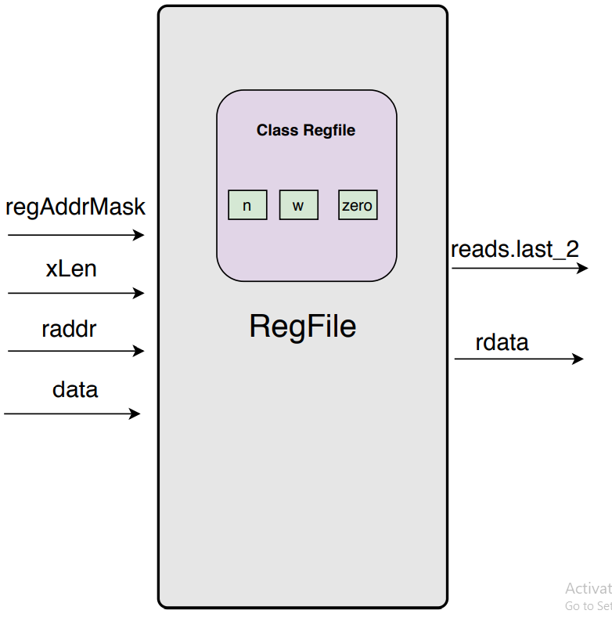
regAddrMask [n] = depth/entry of register file memory
reads.lasts._2 = data read from register file address [31:0]/[63:0]
xLen[w] = width of registers [31:0]/[63:0]
raddr = address of register [4:0]
data = data to be written in the register [31:0]/[63:0]
rdata = data output from register file [31:0]/[63:0]

Slide 17
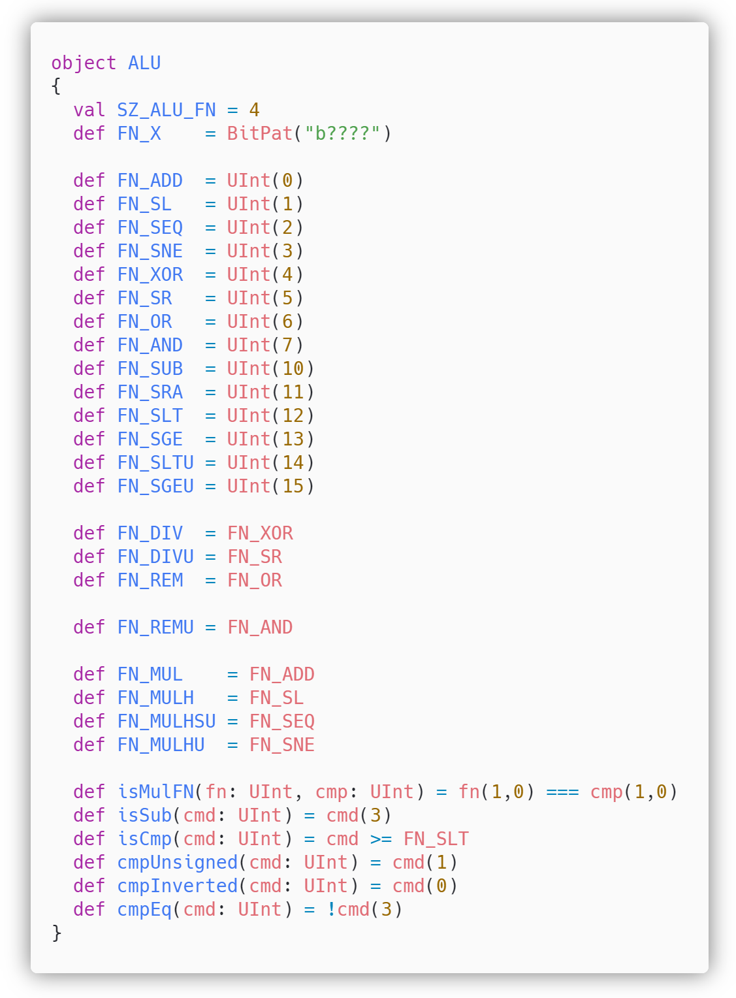
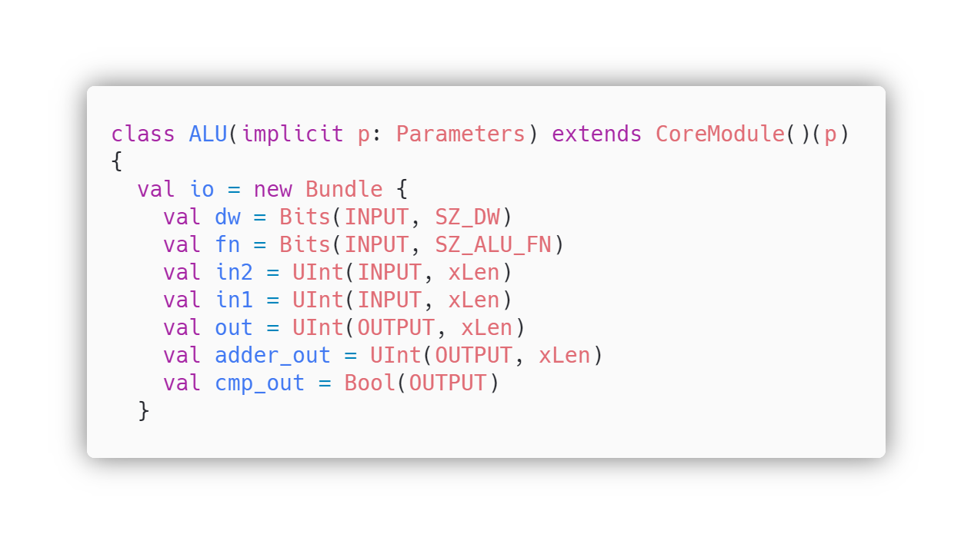
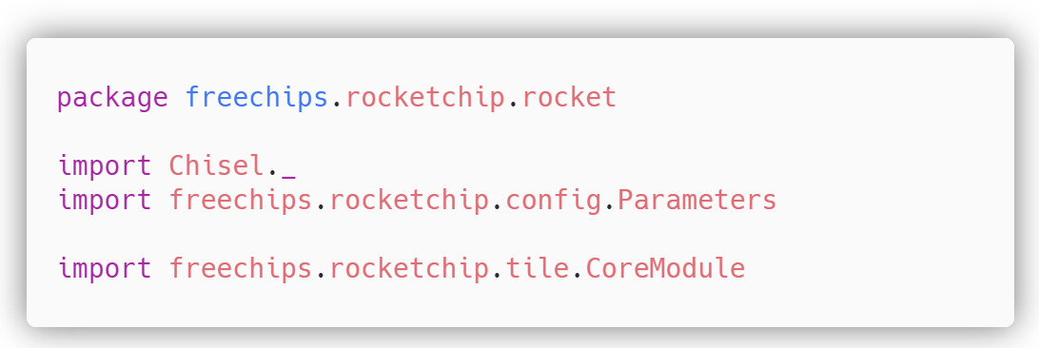
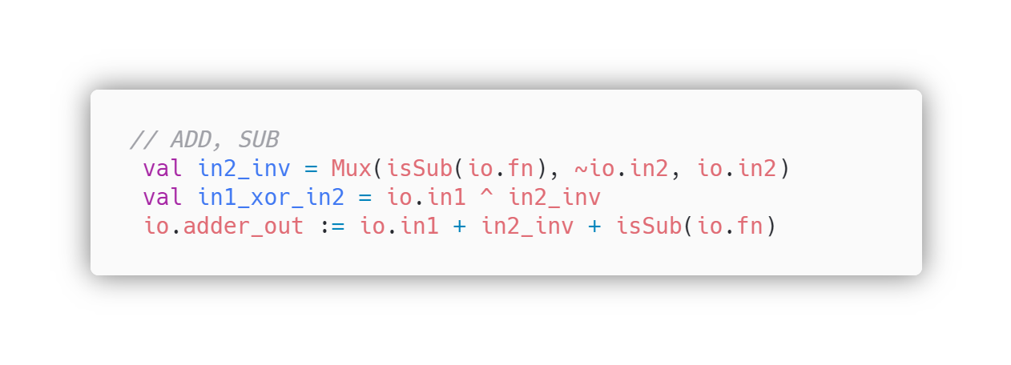
Object ALU is defined
ALU operation bits are defined in method SZ_ALU_FN
ALU operations are defined
Importing all properties of Chisel
Input/Output of class ALU are defined
Class Parameters is imported from directory config of rocket-chip
Class CoreModule is imported from directory tile of rocket-chip

Slide 18
Deep Dive into Rocket-ALU
Class ALU has three inputs and three outputs
ALU I/O | Description
dw | Data width is an input of ALU which can be 32bit or 64 bit
fn | fn (ALU operation Bits) as input, width is predefined by 4
in2 | Operand B input, here xLen can be changed to 32 or 64bits
in1 | Operand A input, here xLen can be changed to 32 or 64bits
out | It is the ALU result output for logical operators, generated by the ALU
adder_out | It is the ALU result output for mathematical operators, generated by the ALU
cmp_out | Branch output weather branch condition True or False

Slide 19
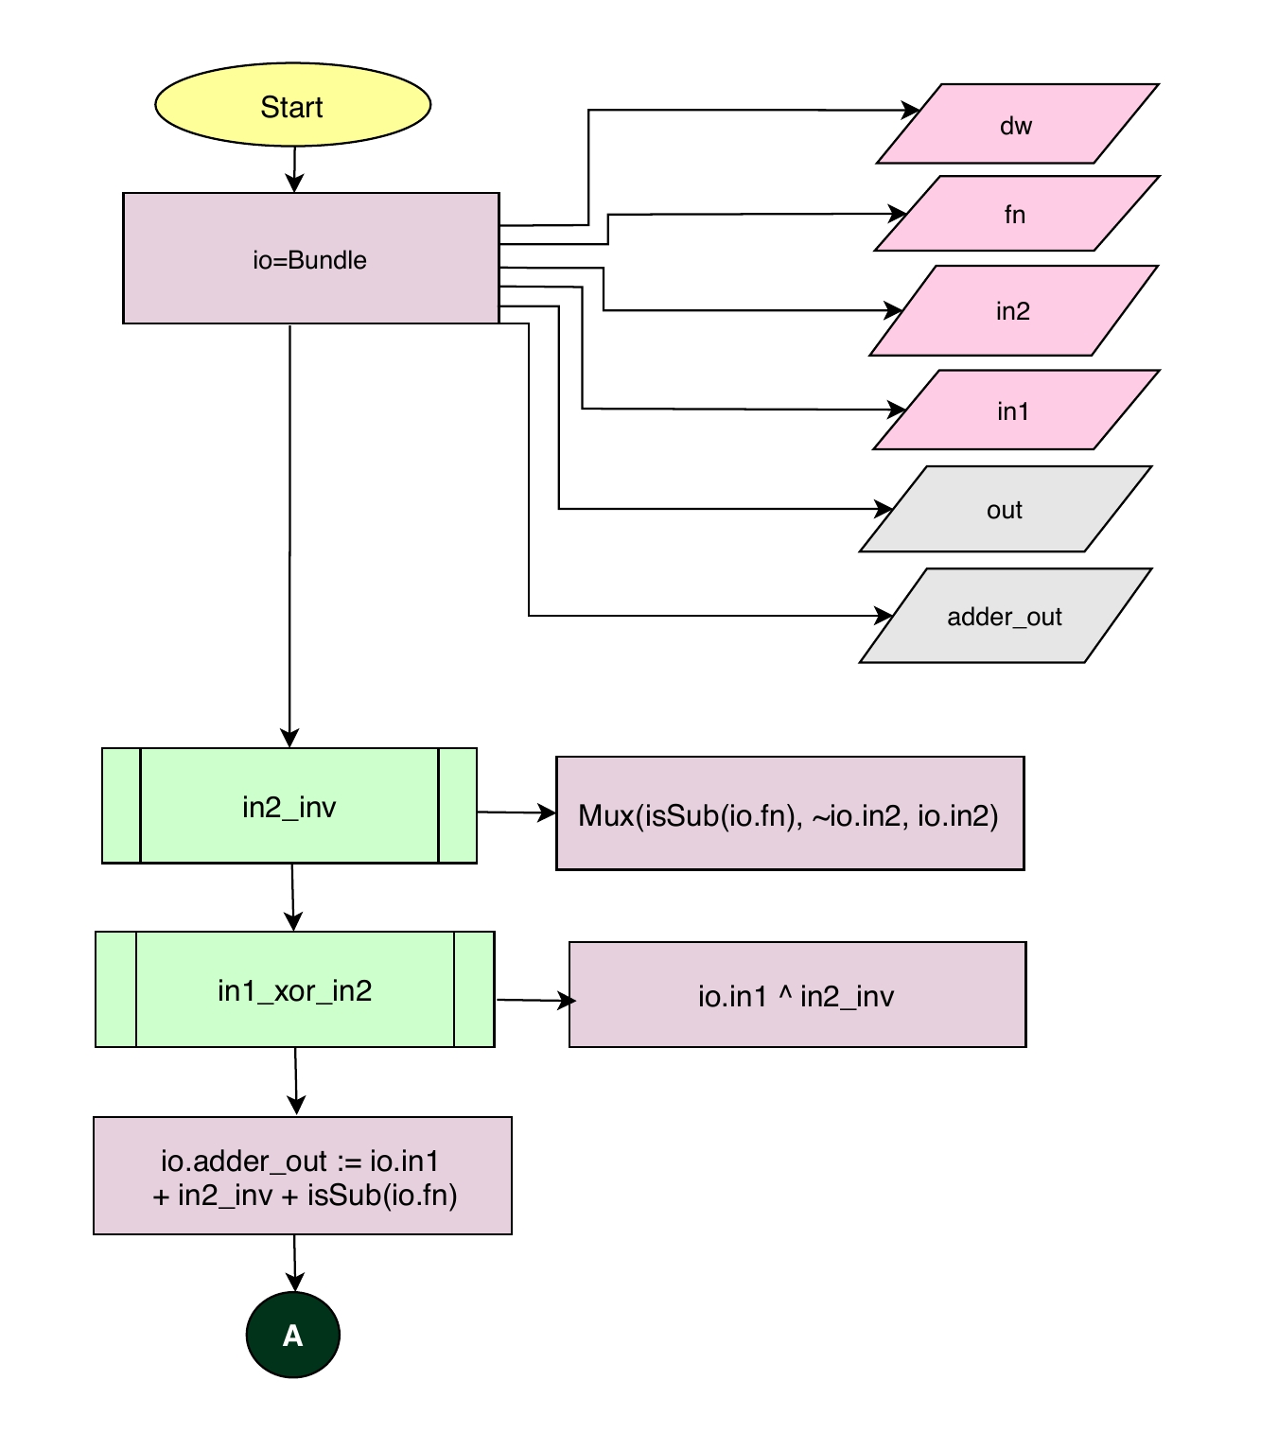
This block of code performs addition and subtraction operation in ALU.
adder_out is used to output the result of addition / subtraction operation performed by ALU
Variable in2_inv is initialized with Mux function which has parameters, isSub function with parameter io.fn as selector, Not of io.in2 as input1 of Mux, and io.in2 as input2 of Mux
Variable in1_xor_in2 is initialized with io.in1 XOR’ed ( ^ ) with in2_inv.
Io.adder_out is wired to io.in1 + in2_inv + isSub of io.fn

Slide 20
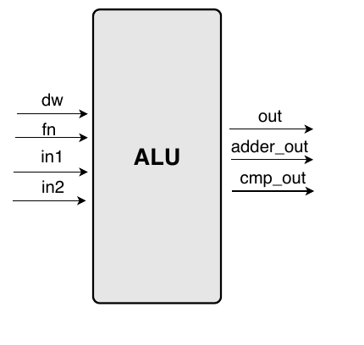
out = ALU result output for logical operators [31:0]/[63:0]
dw = datawidth [31:0]/[63:0]
fn = ALUop bit as input [3:0]
adder_out = ALU result output for mathematical operations [31:0]/[63:0]
In1 = Operand B of ALU as input [31:0]/[63:0]
In2 = Operand A of ALU as input [31:0]/[63:0]
Cmp_out = Branch result output [Bool]

Slide 21
Rocket Core MAS Documentation
This MAS Document provides in depth understanding of Modules of Rocket-Chip SoC.
Explanation of Modules is achieved by means of Block Diagrams, Class Diagrams, Flowcharts, and explanation of all the keywords found in the code.
This MAS Document is essential for those who have basic knowledge of Scala, CHISEL and SoC hardware.
In explanation only the name of keywords is used but their definition is mentioned in the Appendix – Scala & CHISEL keywords.

Slide 22

Aghaz(آغاز) SoC The Beginning

Slide 23
Specifications of Aghaz(آغاز) SoC
RV-32 (32-bit)
I, M & C extensions
64-KB Instruction and Data Cache
CLINT
PLIC
Privileged( Machine)

Slide 24
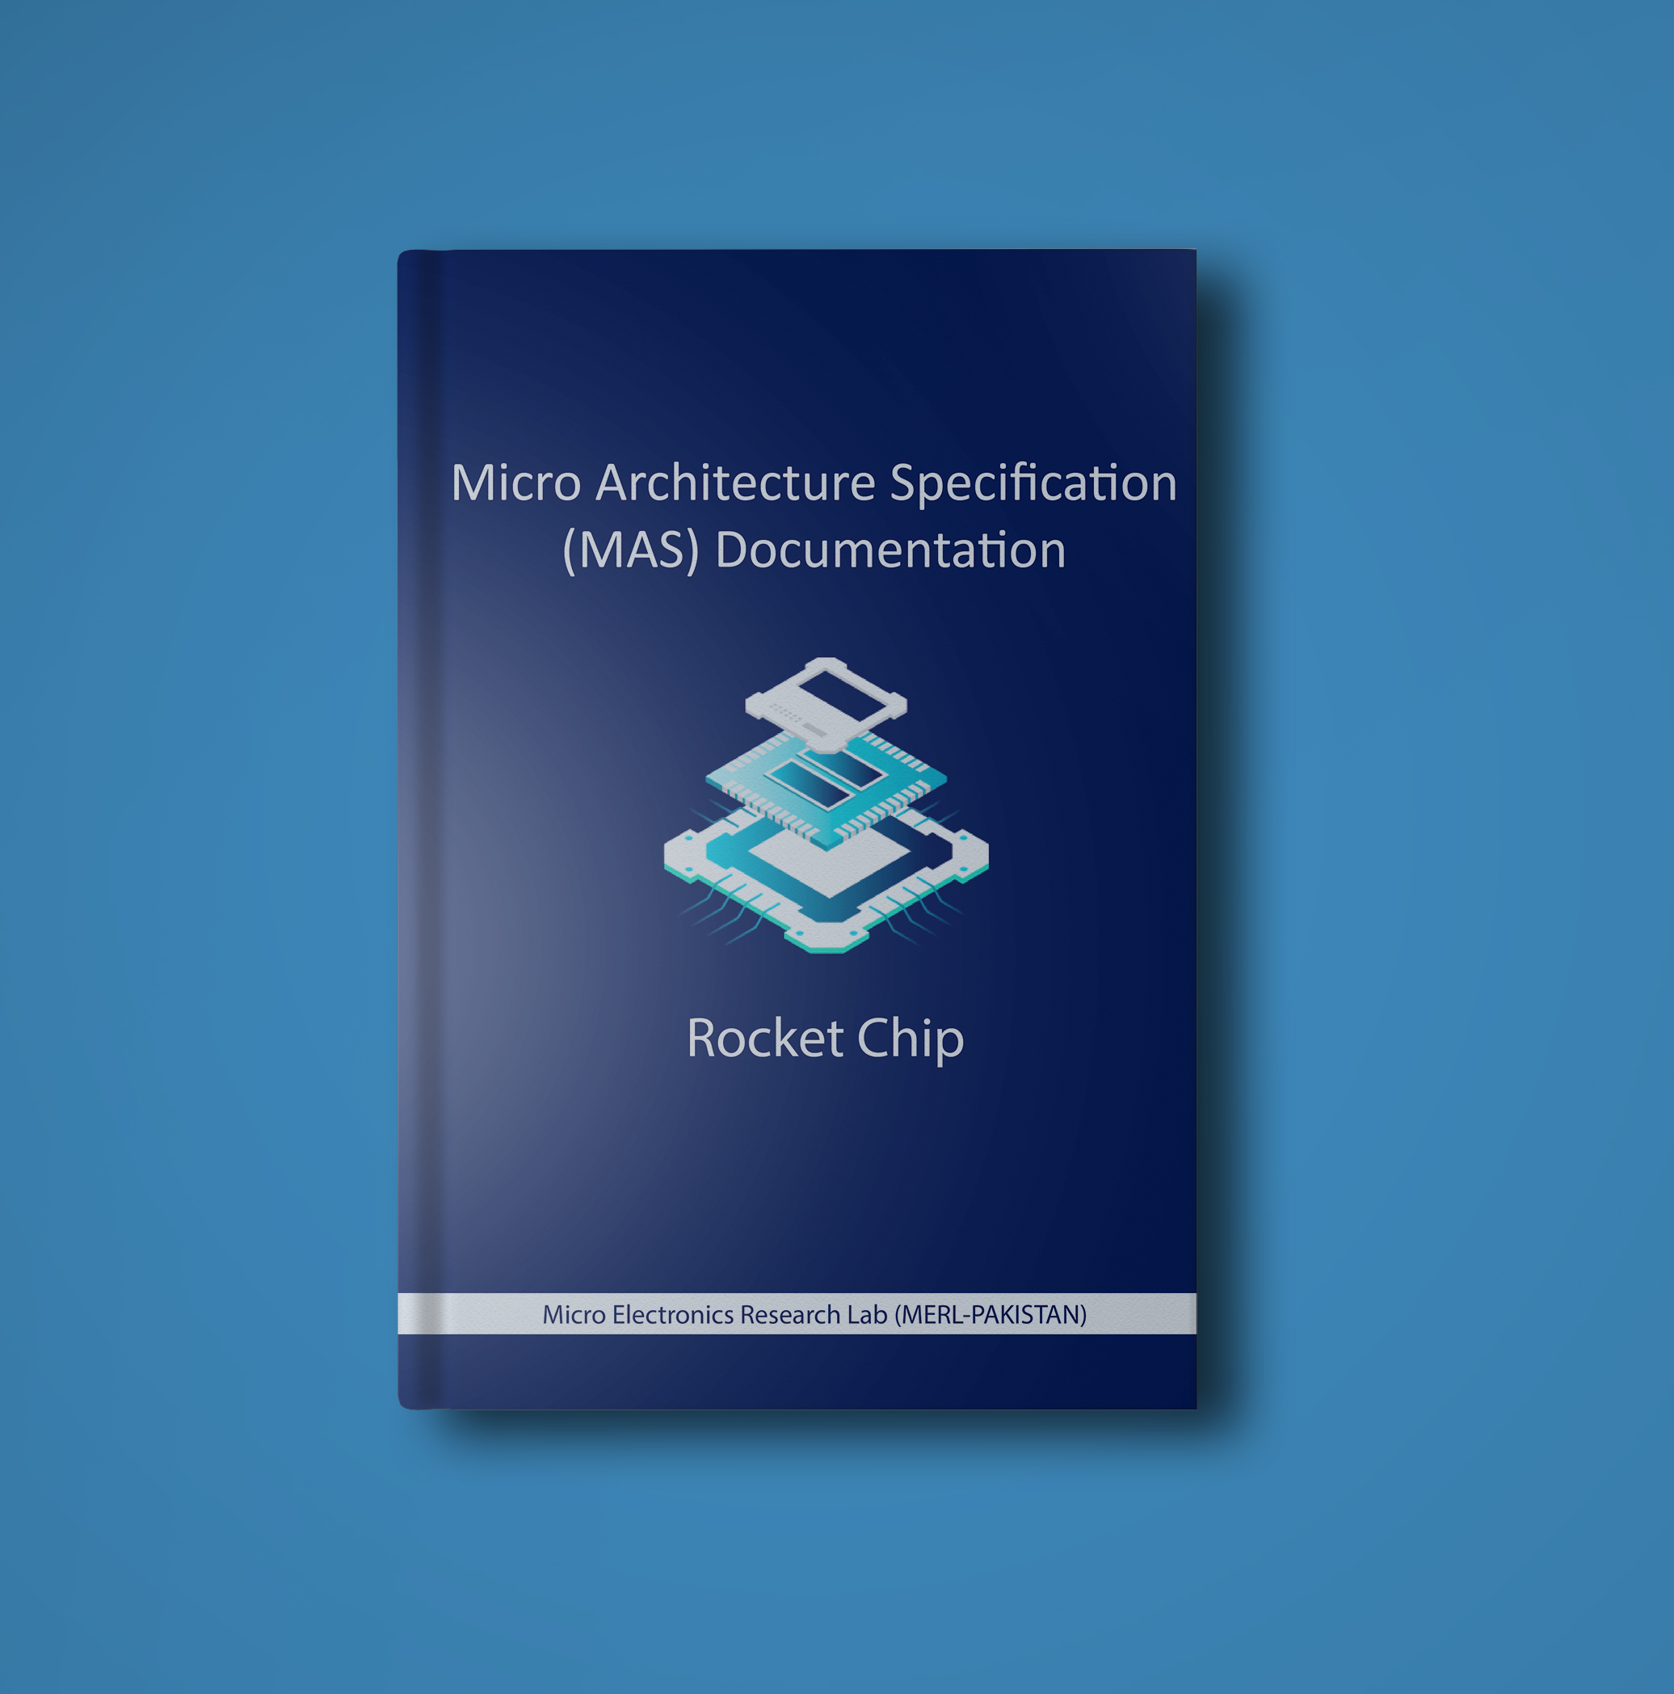
How did we do it?
By using Reverse Engineered MAS Document, which contains in-depth knowledge of all the Modules of Rocket-Chip generated by Rocket-Chip SoC Generator

Slide 25
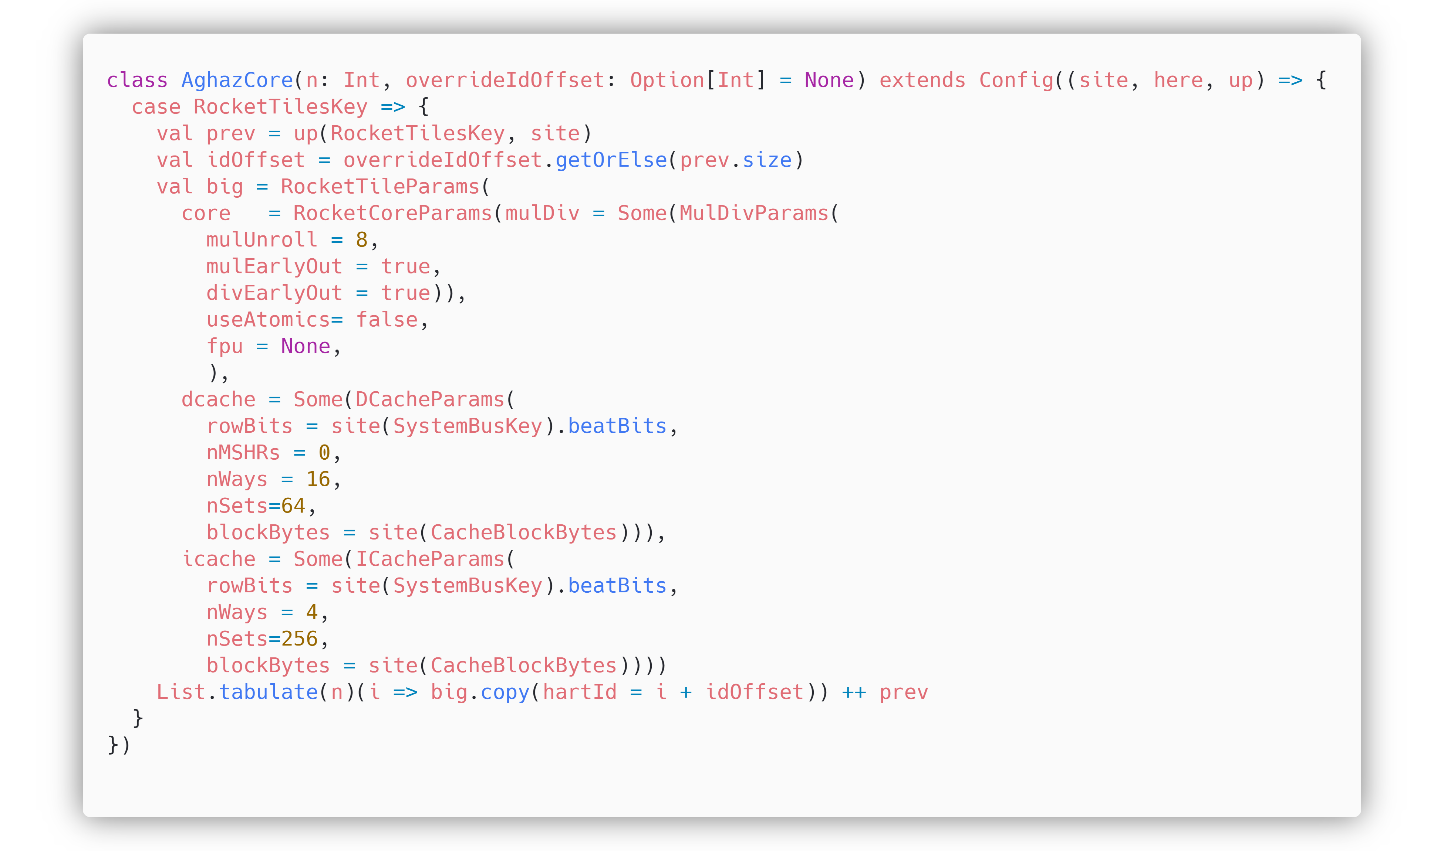
Adding Custom Configuration in Rocket-Chip
Class named AghazCore, contains the configurations for the core level functionality. This class is created in Rocket-chip/src/main/scala/subsystem/Config.scala
Rocket Core parameters
Data Cache parameters
Instruction Cache parameters

Slide 26
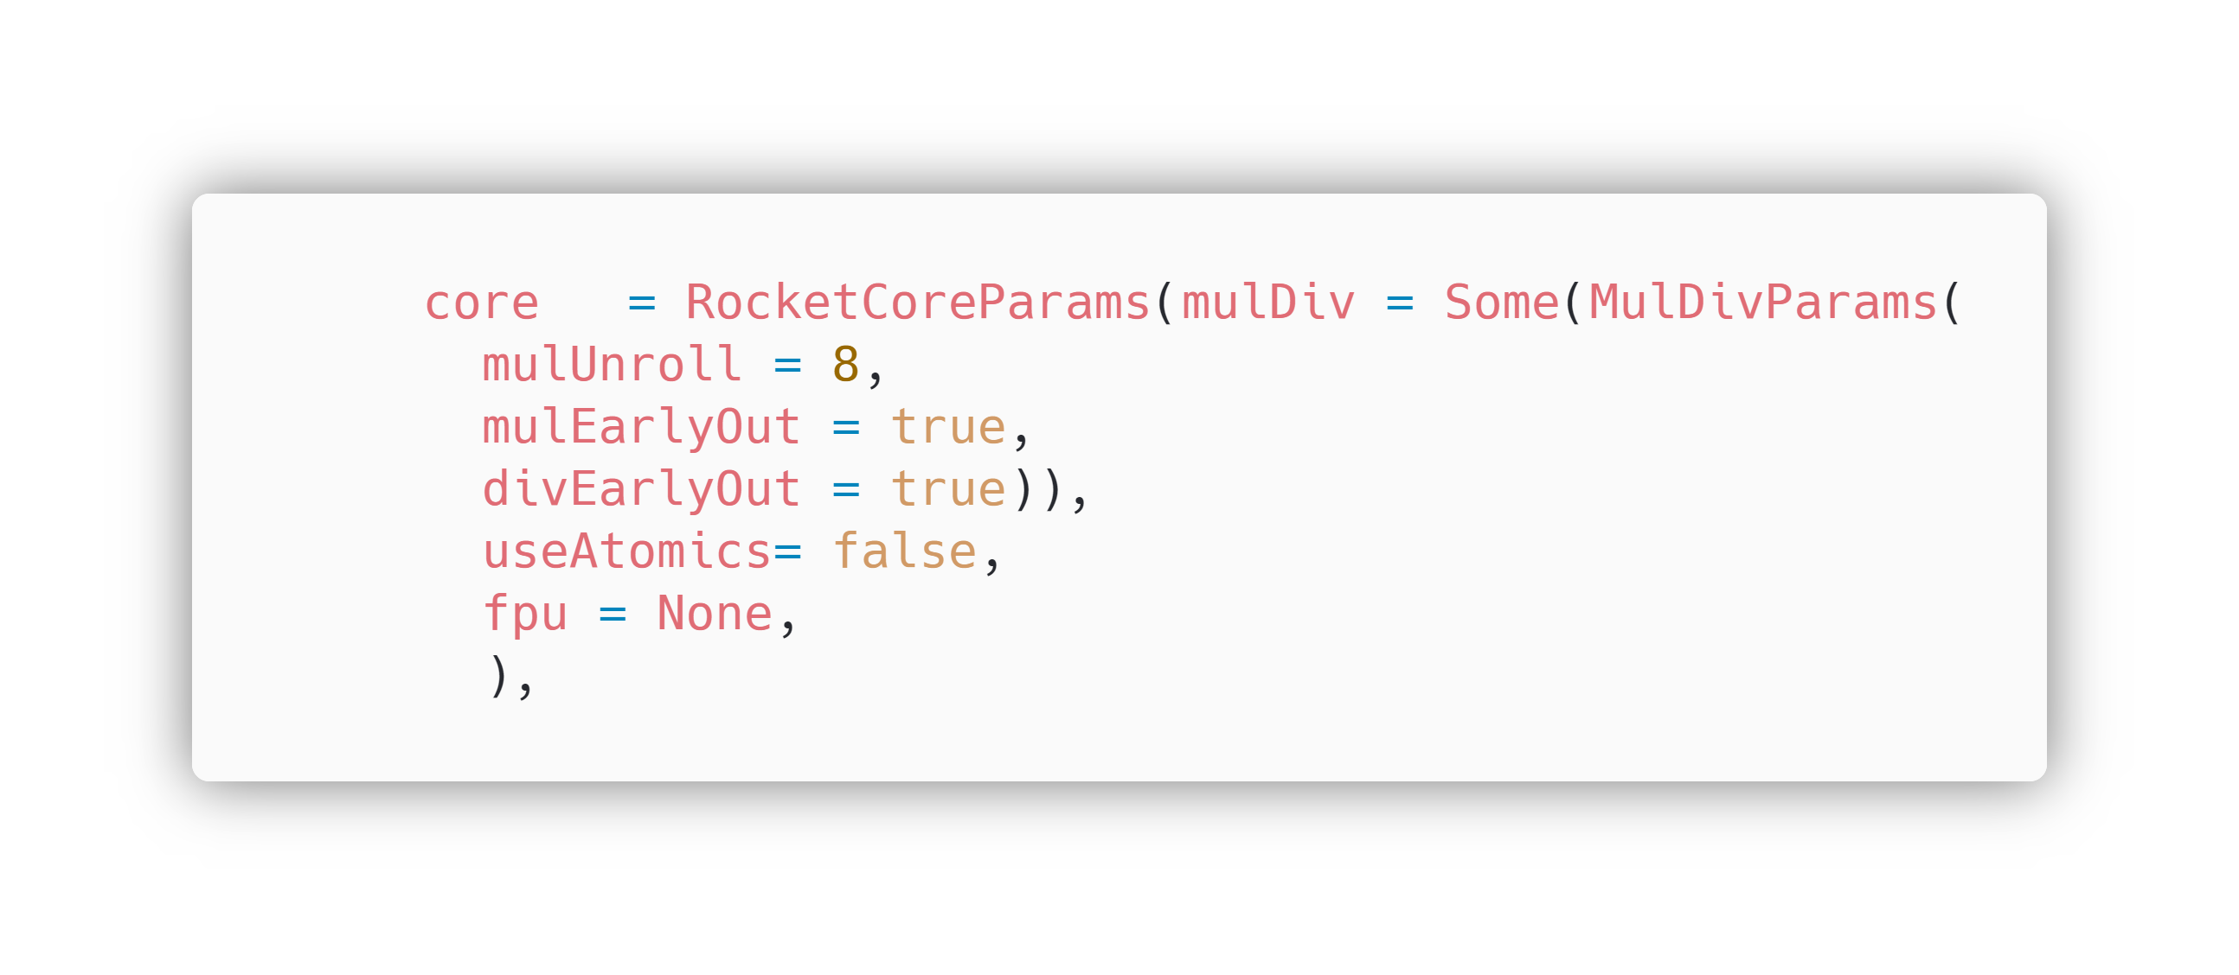
Configuring RV32IMC Core
RocketCoreParams has the parameters for configuring our Core.
We added MulDiv(Multiplier) with MulDivParmas, having default values, in the RocketCoreParams, in order to enable M extension in our Core.
The number of cycles per multiplication.
We updated fpu (Floating-Point unit) to None, to disable F and D extensions in our core.
mulEarlyOut will make the multiplier's latency data-dependent, i.e., it will take fewer cycles to multiply small numbers than large ones.
We updated the value of useAtomics to false, to disable A extension.
divEarlyOut is analogous to mulEarlyOut (smaller numbers divide more quickly than larger ones).

Slide 27
Rocket Core Params (Core)
In the RocketCoreParams, useCompressed is true, means C extension is enabled by default.
I extension is the base Extension and is also enabled by default.
Hence, our core is configured to support I, M and C Extensions.
useCompressed | true | useCompressed is for C-extension, it is true by default, means our Core will have C-extension enabled implicitly.

Slide 28
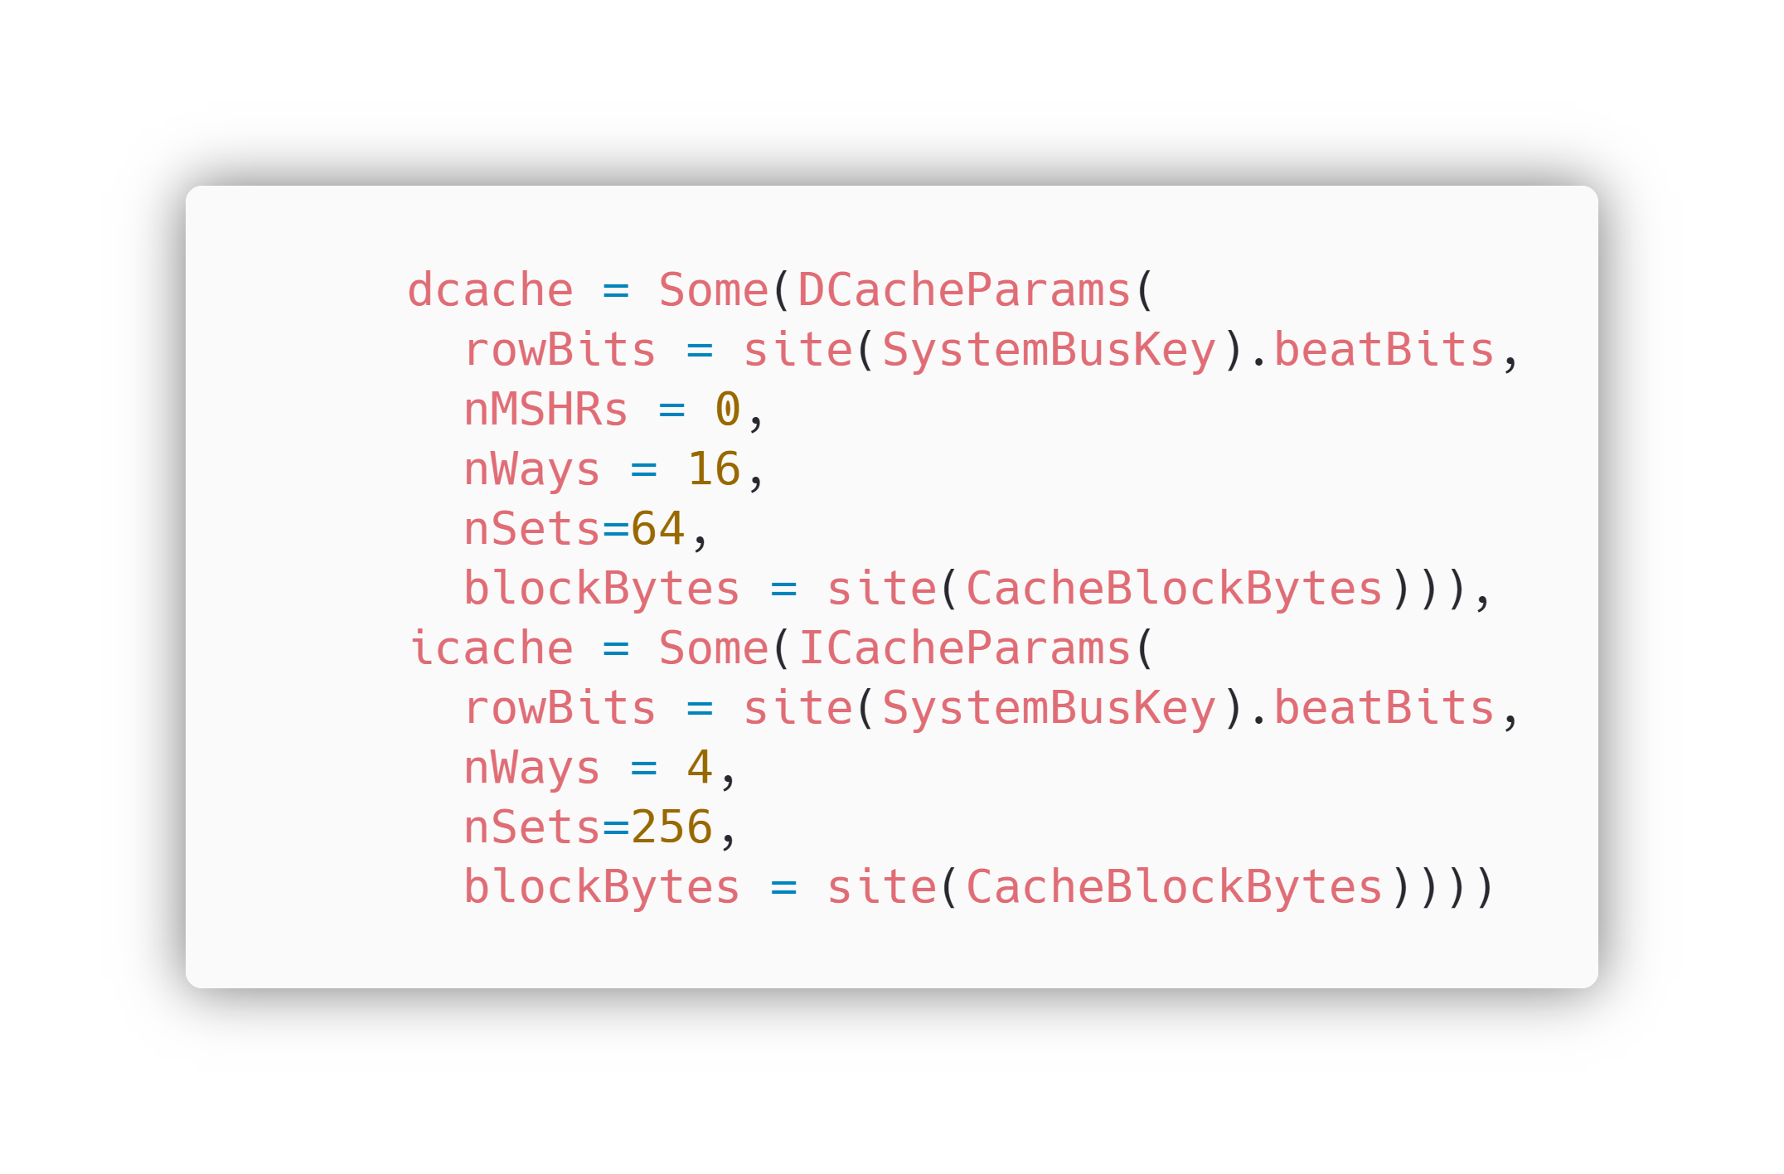
Configuring the cache and dcache in Aghaz Core
dcache has DCacheParams, which will set Data Cache parameters. Similarly, icache has ICacheParams, which are parameters for configuring Instruction Cache.

Slide 29
Data Cache Parameters
Parameters | Value | Description
nMSHRs | 0 | There are 0 MSHRs (Miss Status Handling Registers) in Instruction Cache
nWays | 16 | There are 16 Ways of Cache in DCache
nSets | 64 | There are 64 Sets of Cache in DCache
blockBytes | 64 (evaluated) | There are 64 blockBytes in DCache
Size of DCache is calculated by: nWays x nSets x blockBytes (16 x 64 x 64 == 64KB)
Instruction Cache Parameters
Parameters | Value | Description
nWays | 4 | There are 4 Ways of Cache in ICache
nSets | 256 | There are 256 Sets of Cache in ICache
blockBytes | 64 (evaluated) | There are 64 blockBytes in ICache
Size of ICache is calculated by: nWays x nSets x blockBytes (4 x 256 x 64 == 64KB)

Slide 30
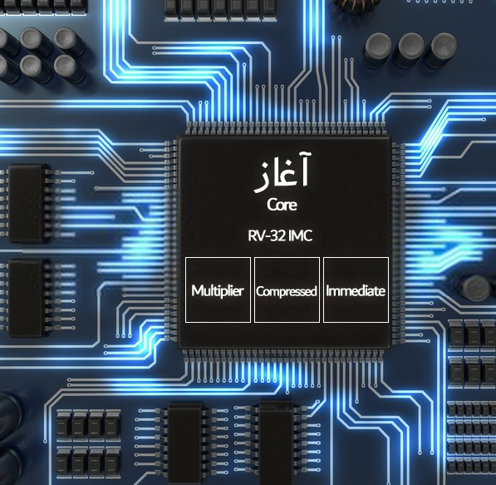
Blocks of Core
Aghaz Core contains, I, M and C extensions, with 32-bit compatibility.

Slide 31
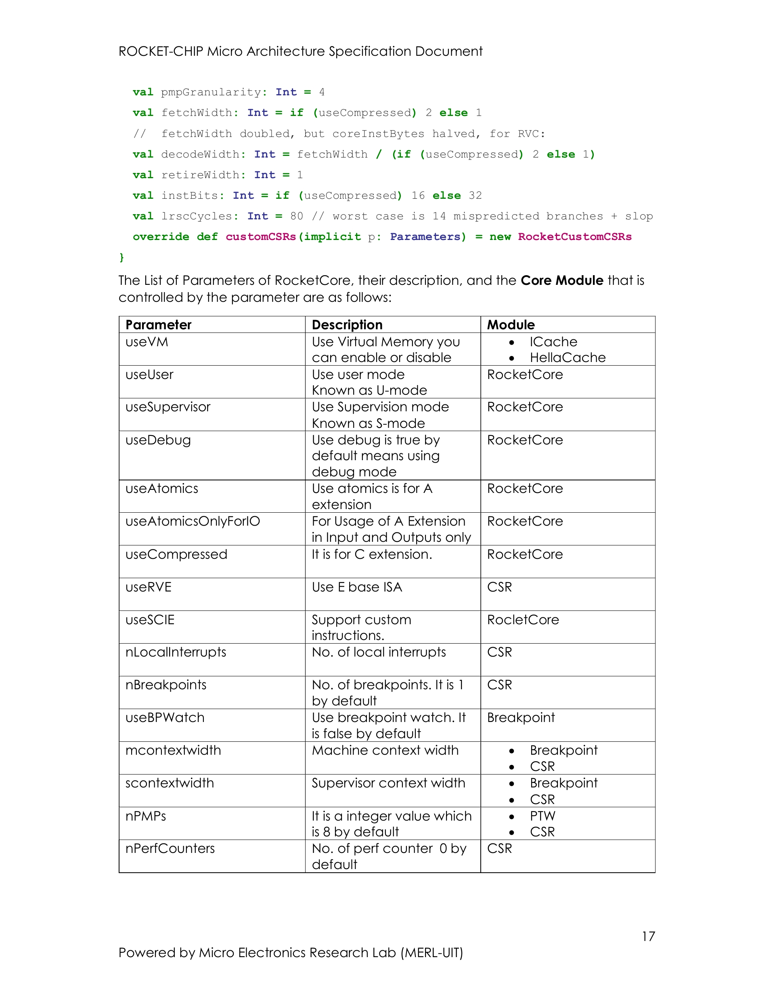
How did we know, which parameter is doing what?
The Parameters, their description and the modules which is controlled by that parameter is mentioned in the MAS Document.

Slide 32
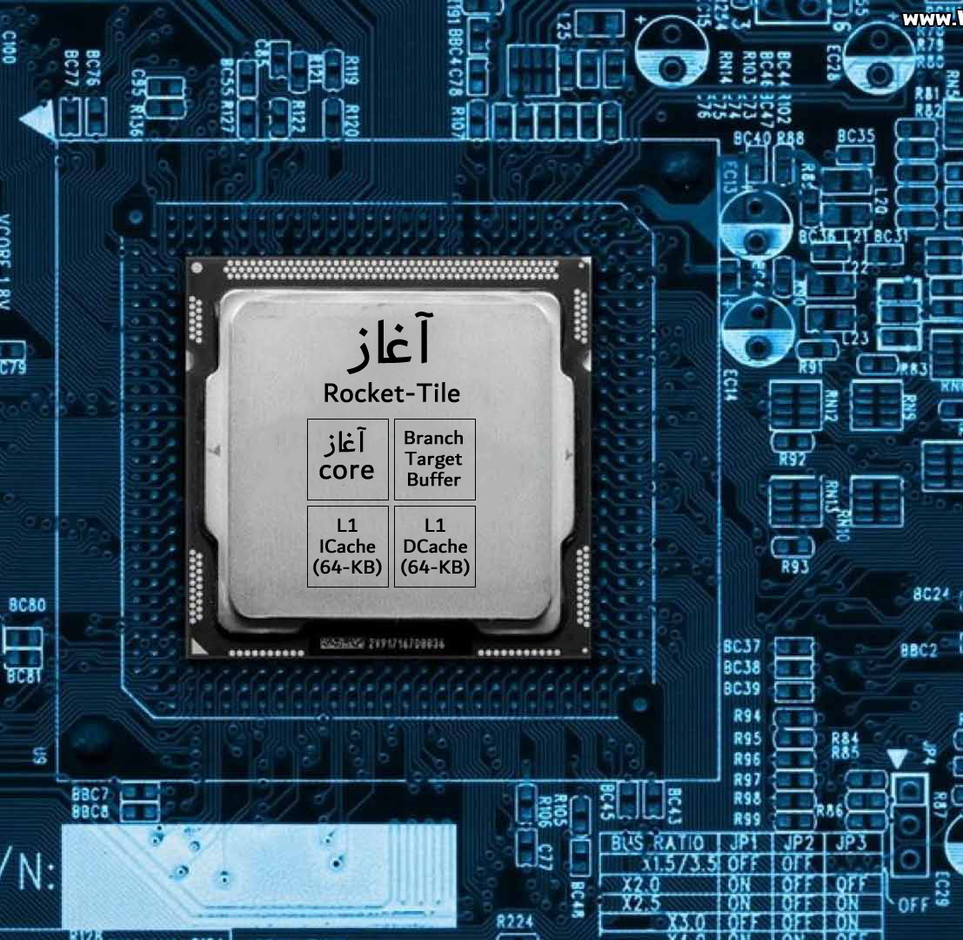
Blocks of Tile
Rocket-Tile of Aghaz SoC contains Aghaz Core, Branch Target Buffer, L1 Icache & DCache of 64-KB

Slide 33
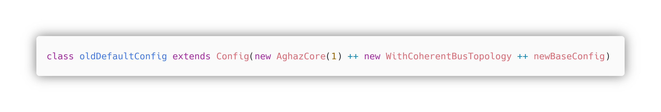
Initializing Aghaz Core to Default Configuration
Default Configuration is created in Rocket-chip/src/main/scala/system/Config.scala
Class named oldDefaultConfig is created extended/ inherited by Config class.
Class Config (Parent Class) contains the main configurations, all the configurations have to be inherited from this class.
AghazCore object is created with ‘1’ as a parameter, which indicates that our AghazCore has only single(1) core.
AghazCore object is further added with object of WithCoherentBusTopology, which contains the Bus level configurations.
Further these objects are added with newBaseConfig object, which contains the base configurations.

Slide 34
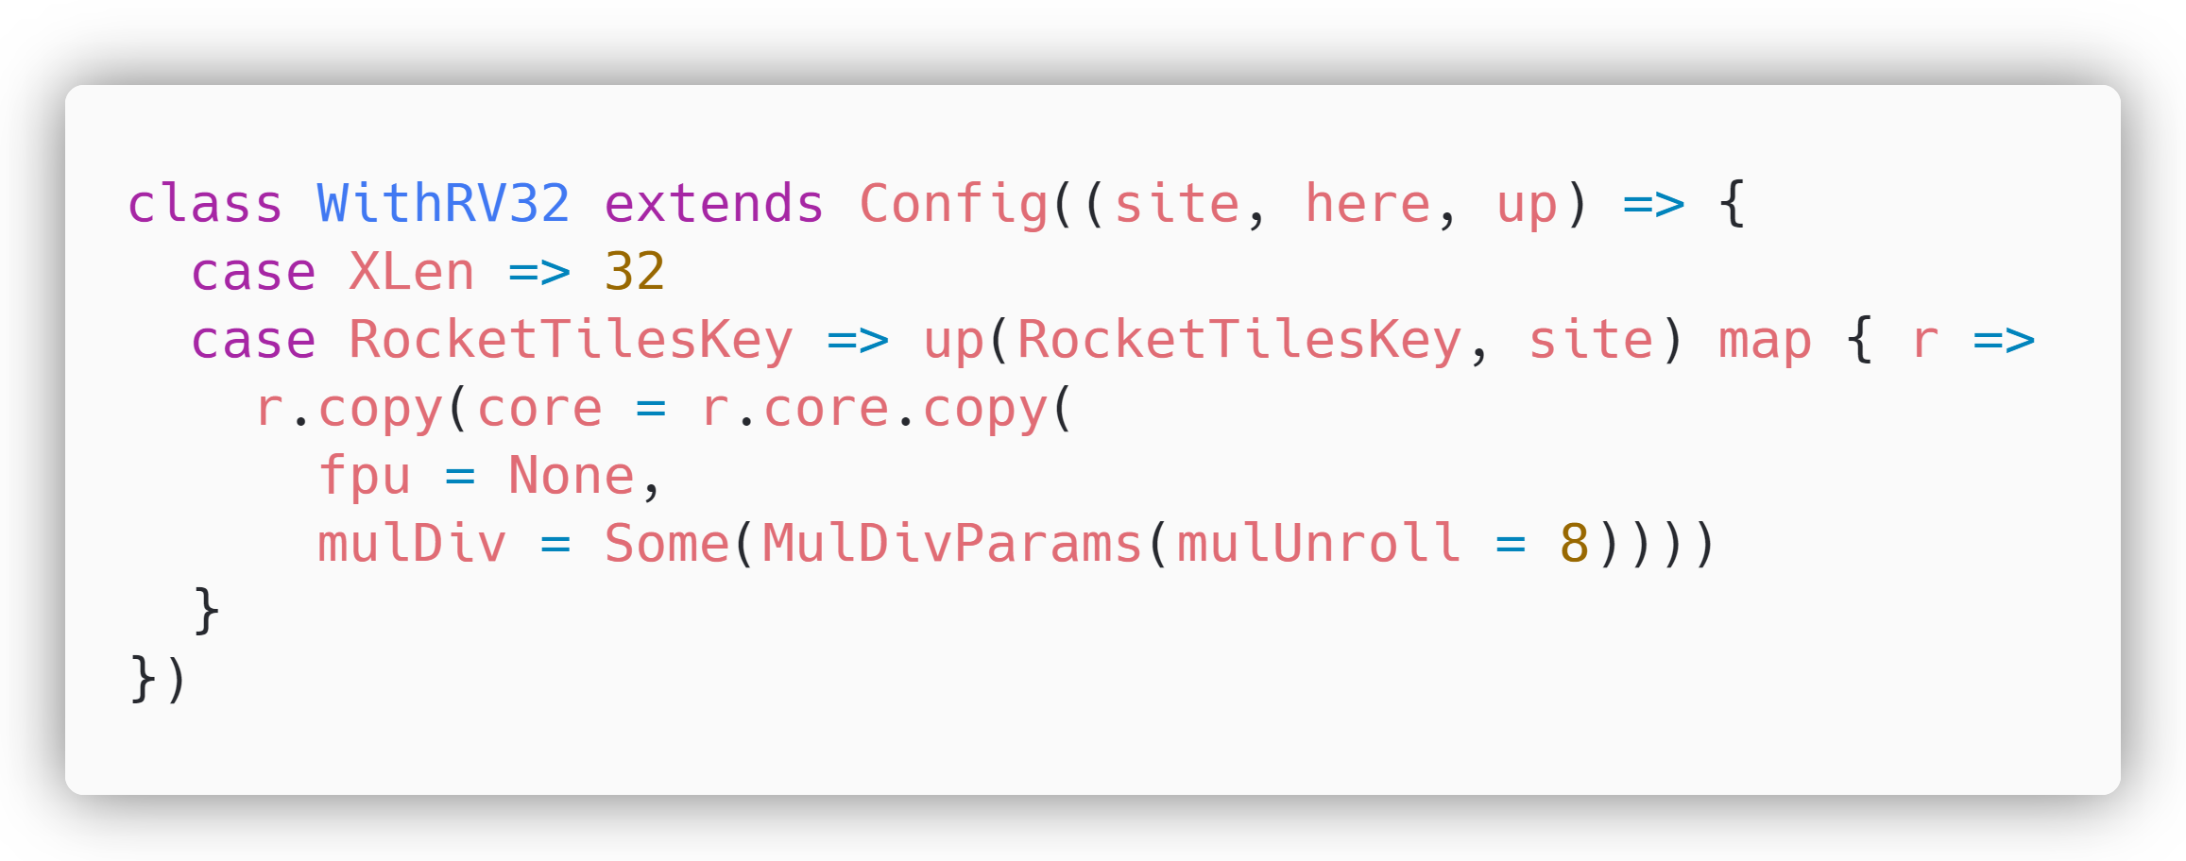
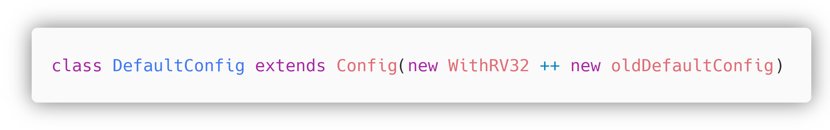
Customizing AghazCore to 32-bit Configuration

Slide 35

Blocks of SoC

Slide 36
At this point our Aghaz SoC is successfully configured and ready to be built.

Slide 37
Configuring an SoC to your Requirements in a quick process by means of this MAS Document

Slide 38
Acknowledgements This Document was made possible with the counselling, guidance and support of Dr.Roomi Naqvi, Dr Ali Ahmed Ansari, and Farhan Ahmed Karim. Without their encouragement and guidance, this could not be possible. This Document was created under the Lead of Uzair Khan, along with the team of collaborators/ interns under him that gave their level best under the supervision of such experienced mentors.
Team Members
Waleed Waseem
Shahzaib Kashif
Talha Ahmed
Mohsin Raza
Muhammad Shahzaib
Syeda Fizza Jaffery
Almas Ibrahim
Ubab Nadeem

Slide 39
December 8-10 | Virtual Event
Thank you for joining us.
Contribute to the RISC-V conversation on social!
#RISCVSUMMIT @risc_v

Slide 40
https://docs.boom-core.org/en/latest/sections/intro-overview/rocket-chip.html

